Slide 1



Smart Monitoring Systems for Autonomous Vehicles Using IoT
Name of Candidate : MUHAMMAD ANSHAD P A
Register No : 23204036 Date : 27-11-2024
Venue : RCSS
Programme : MCA
Batch : 2022-2024

Slide 2
CONTEXT OF THE TOPIC
Autonomous Vehicles (AVs)
AV - self-driving cars - minimal or no human intervention
They combine AI,ML, and sensory data - navigate safely and efficiently- sense their environment, make informed decisions - adapt to dynamic road conditions.
Evolution of AV - cruise control in the 1950s - evolved -advanced systems : adaptive cruise control, lane-keeping assistance
Tesla, Waymo , and Uber
Importance of IoT in Transportation
interconnected devices. nervous system- connecting sensors, processors, and communication systems.
Backbone - "sense," "think," and "act."
Role of IOT ? - Data collection , communication , predictive Maintenance.
Tesla's Autopilot - •lane detection, traffic monitoring, and obstacle avoidance.
Problem Statement -relevancy ?
Global push - sustainable and smart cities .
road accidents caused by human error , traffic management , fuel consumption and carbon emissions.

Slide 3
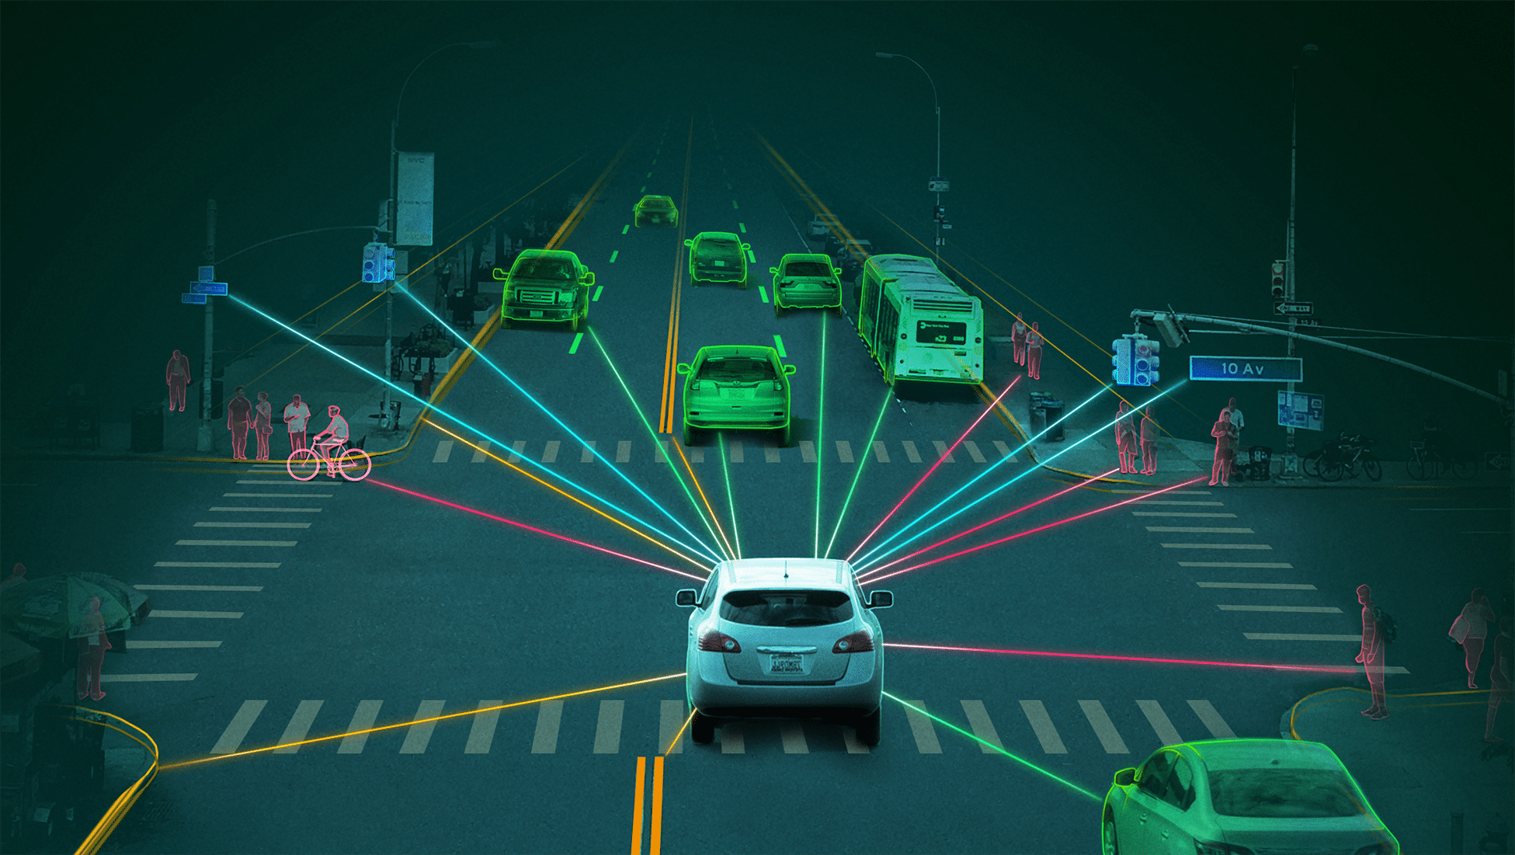
INTRODUCTION
Autonomous vehicles (AVs) are revolutionizing transportation by utilizing advanced technologies like Artificial Intelligence (AI), Machine Learning (ML), and the Internet of Things (IoT) to operate without human intervention. IoT plays a critical role in enabling these vehicles to monitor their environment, process real-time data, and make informed decisions. By integrating sensors, communication systems, and cloud computing, IoT enhances the safety, efficiency, and adaptability of AVs, paving the way for smarter and more sustainable transportation solutions. This seminar explores how IoT-based smart monitoring systems address challenges and improve the functionality of autonomous vehicles.

Slide 4

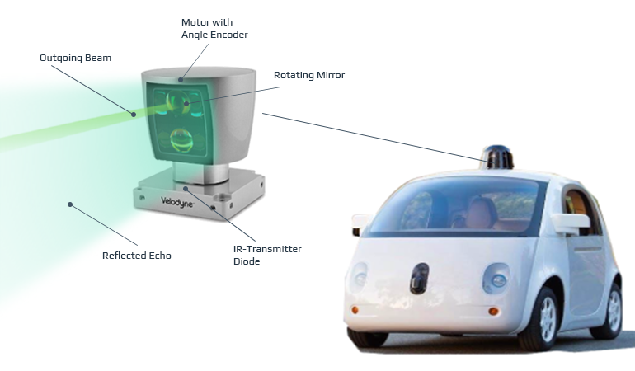
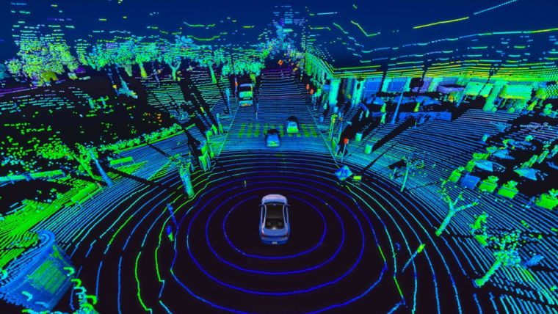
COMPONENTS OF STUDY
IoT Sensors in AVs
LiDAR (Light Detection and Ranging)
laser pulses - measure distances , 3D map
How it Works ? - rotating emitter - return time
Application ? -Waymo - obstacle detection, path planning.
Advantages ?
Limitations ? - Extreme weather

Slide 5
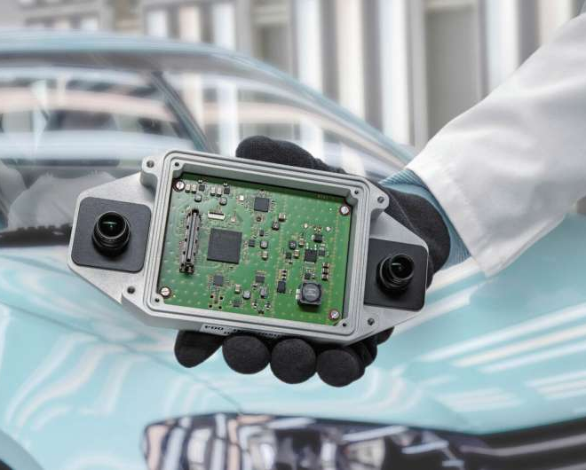
COMPONENTS OF STUDY
Radar
Speed, distance, and movement of objects.
Tesla - • Adaptive Cruise Control (ACC) mode.
How it Works ? - radio waves - Doppler effect
Cameras
Capture visual data for lane detection, traffic signs, and obstacle identification.
How it Works ? - ML algorithms
Tesla's Full Self-Driving (FSD)

Slide 6
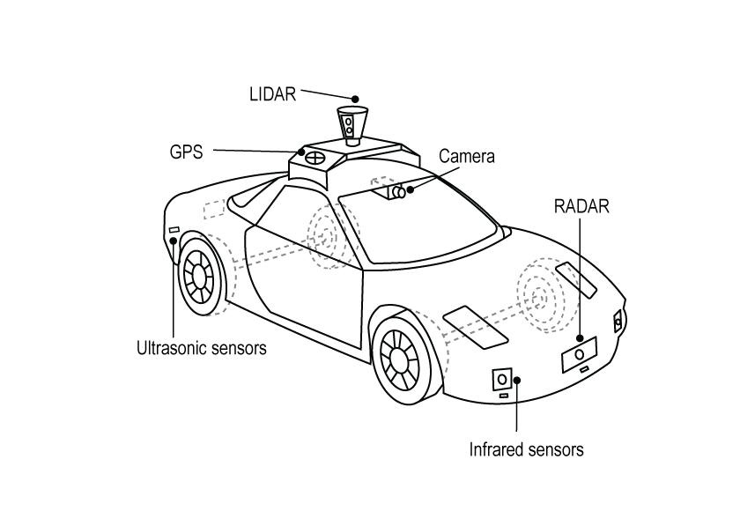
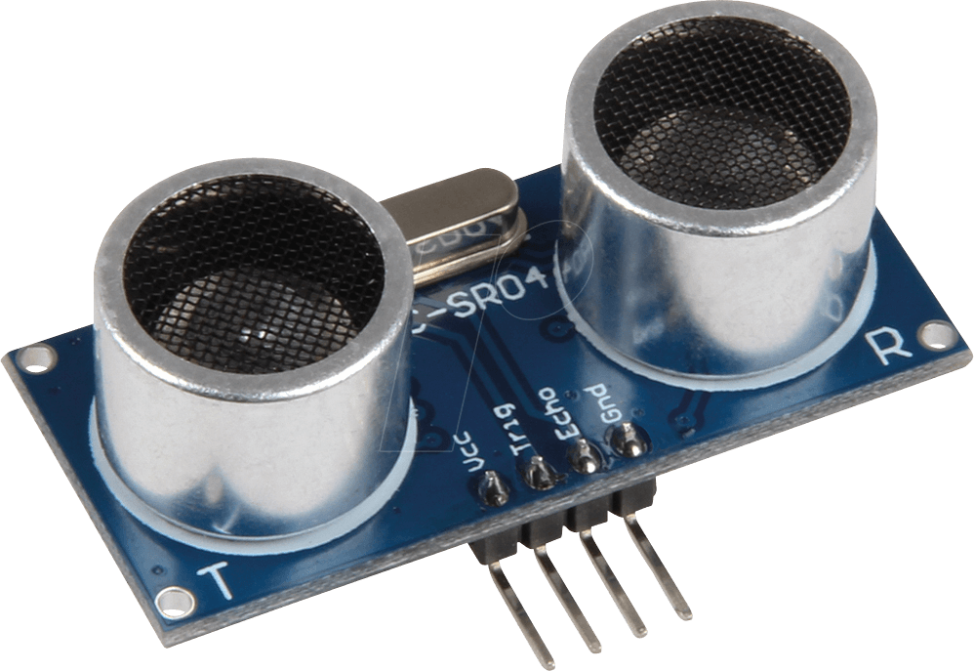
COMPONENTS OF STUDY
GPS
Provides accurate location data for navigation and route planning.
Uber - Ride hailing
Ultrasonic Sensors
Detect nearby objects for low-speed operations like parking.
How it works ? - ultrasonic waves
Reverse Park Assist in BMW and Audi

Slide 7
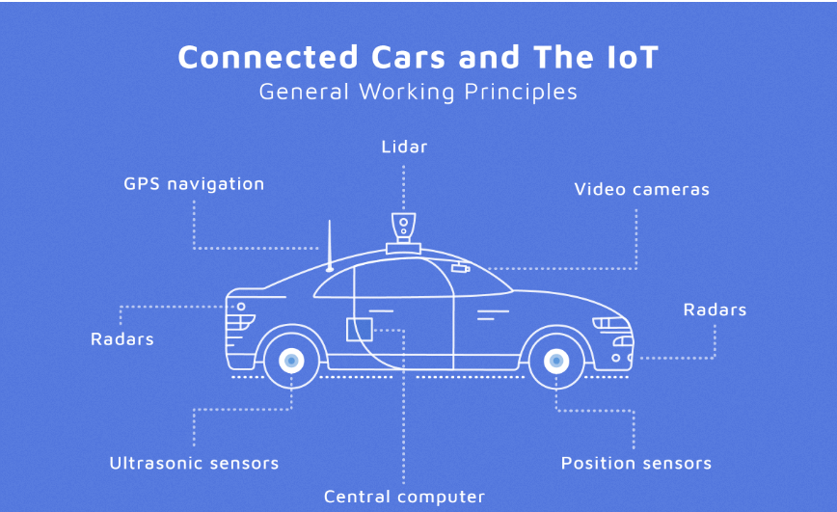
COMPONENTS OF STUDY
Central Computer
Information from all the sensors is analyzed by a central computer , based on the information received the software takes self driving decisions such as steering , accelerator and brakes.

Slide 8
COMPONENTS OF STUDY
Technologies for Data Processing and
Communication
Edge Computing:
Processes data close to the vehicle - reducing latency
Tesla’s onboard computer, Hardware 3.0 - camera feeds
5G Networks:
Provides high-speed, low-latency connectivity between vehicles and the cloud.
Qualcomm : 5G-enabled vehicle communication systems
Application ? - V2X
Cloud Computing:
Stores large volumes of data for analysis and long-term insights.
Google Waymo - analyze driving patterns

Slide 9
COMPONENTS OF STUDY
Algorithms and Software Systems
Advanced Driver Assistance Systems (ADAS):
Perception: Detects and classifies obstacles.
Localization: Determines vehicle’s position in its environment.
Planning: Maps the safest and most efficient route.
Control: Executes the planned actions (e.g., braking, steering).
Machine Learning Algorithms:
NVIDIA’s self-driving car - CNNs and YOLO algorithms
CNNs (Convolutional Neural Networks): Recognizes objects from sensor data.
Examples: HydraNet (Tesla), ChauffeurNet (Waymo)
Data Reduction Techniques: Simplify and classify large datasets.
Example: Waymo - YOLO (You Only Look Once) to detect obstacles

Slide 10
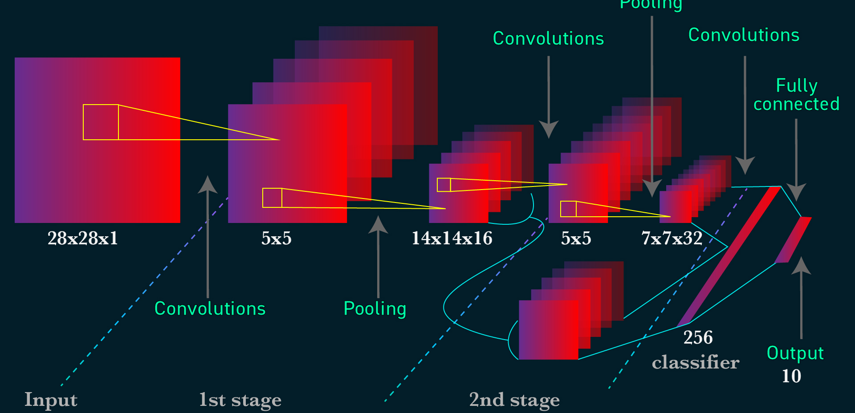
COMPONENTS OF STUDY
CNN-
for image classification and recognition

Slide 11
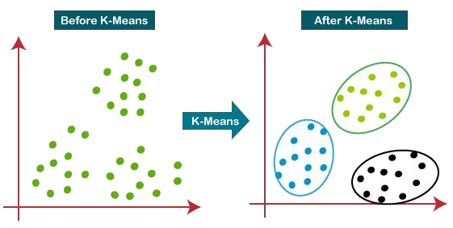
COMPONENTS OF STUDY
Clustering Algorithms
Identify patterns in sensor data for accurate object classification.
Examples: K-means, Multi-class neural networks.
Regression Models
Predict the future state of objects in the environment.
Examples: Regression random forest, Bayes regression.

Slide 12
COMPONENTS OF STUDY
Communication Protocols
V2X (Vehicle-to-Everything): Enables interaction between the vehicle and external systems.
V2V (Vehicle-to-Vehicle):
Vehicles share data on speed, position, and route intentions - avoid collisions .
General Motors’ Cadillac CTS Sedan
V2I (Vehicle-to-Infrastructure):
Communicates with traffic lights, road signs, and infrastructure for route optimization.
Audi’s Traffic Light Information System
V2N (Vehicle-to-Network):
Connects vehicles to the cloud for broader data analysis and updates.
V2P (Vehicle-to-Pedestrian):
Detects and interacts with pedestrians for safety in urban environments.

Slide 13
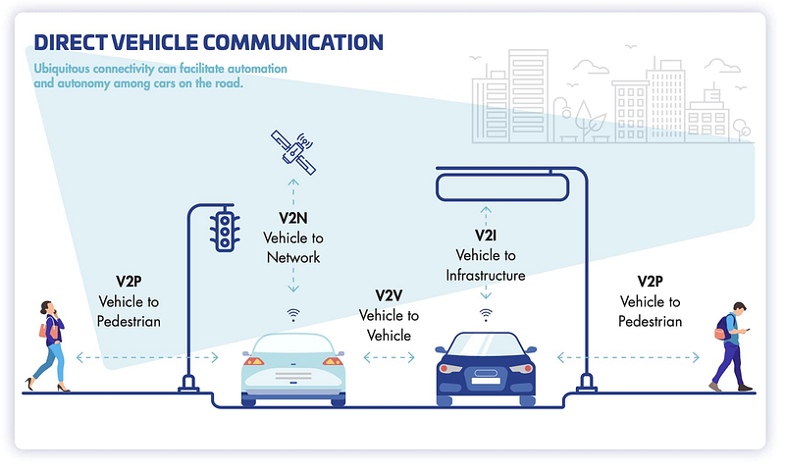
COMPONENTS OF STUDY

Slide 14
COMPONENTS OF STUDY
Power Management Systems
Efficient power usage is critical for IoT-enabled AVs, which rely heavily on sensors and processing units.
Energy-Efficient Sensors:
optimized to consume minimal power without compromising functionality.
Low power LiDAR
Battery Management System:
Monitors battery health - Optimize Charging - overheating
Tesla’s BMS .
Regenerative Systems:
Using kinetic energy from vehicle motion to recharge batteries.

Slide 15
INTERPRETATION OF THE CASE
Key Observations
Integration of Sensors:
High Accuracy .
Redundancy - One sensor affected
Impact of V2X Communication:
Improve traffic flow, reduce congestion, and enhance safety .
Eg: if a car detects a sudden stop ahead, it can send this data to nearby vehicles, preventing a pile-up.
Real-Time Data Processing:
Edge computing reduces latency, ensuring faster responses to dynamic situations (e.g., sudden obstacle detection).
Eg: a child suddenly crosses the road
Predictive Maintenance:
forecast component failures, reducing unexpected breakdowns and maintenance costs.

Slide 16
INTERPRETATION OF THE CASE
Advantages of IoT in AV Monitoring Systems
Improved Safety:
respond to obstacles faster than humans - reducing accidents.
Adaptive cruise control and automated braking systems enhance passenger safety.
Enhanced Efficiency:
real-time traffic monitoring and route optimization - time and fuel consumption.
Situation : You are driving to work during rush hour- heavy traffic . - Monitoring - V2I
Environmental Benefits:
carbon emissions- smart driving pattern , efficient routing.
Eco-friendly driving .
Eg: Tesla - minimal energy wastage during long trips
Better Traffic Management:
IoT enables vehicles to interact with smart infrastructure, leading to smoother traffic flow.
Situatuion : Shopping Mall

Slide 17
THE EXPERIMENT
Experiment Setup
Hardware Components:
Sensors: LiDAR, radar, cameras, ultrasonic sensors, and GPS modules.
Processing Units: Edge computing devices for local data processing and cloud servers for large-scale analysis.
Communication Devices: 5G-enabled modules for V2V and V2I communication
Software Components:
Machine Learning Algorithms: Convolutional Neural Networks (CNNs) for object detection, Principal Component Analysis (PCA) for data reduction, and YOLO for obstacle classification.
IoT Platform: A centralized system for managing connected devices, collecting data, and enabling decision-making.
Testing Environment:
Urban Scenario: Simulated city environment with heavy traffic and dynamic obstacles.
Highway Scenario: High-speed travel with fewer obstacles but varying weather conditions.
Controlled Lab Testing: Ensuring sensor accuracy and algorithm performance in a controlled environment.

Slide 18
THE EXPERIMENT
Process and Results
Process:
Step 1: Sensors collected real-time data on vehicle surroundings (obstacles, lane markings, traffic signs).
Step 2: Edge computing processed data locally to make instant decisions (e.g., braking or steering).
Step 3: Data was transmitted to the cloud for long-term storage and trend analysis.
Step 4: Machine learning algorithms analyzed data to improve decision-making (e.g., recognizing patterns in pedestrian movement).
Step 5: Predictive maintenance systems used sensor data to anticipate potential failures and generate alerts.
Key Results:
Obstacle Detection Accuracy: IoT-enabled sensors achieved 95% accuracy in detecting and classifying objects in varied environments.
Latency Reduction: Edge computing reduced response time by 40% compared to traditional cloud-only systems.
Traffic Flow Optimization: V2X communication improved traffic flow by 30%, reducing congestion in urban areas.
Maintenance Efficiency: Predictive systems reduced unexpected breakdowns by 25%, enhancing vehicle uptime.
Weather Adaptability: While performance declined slightly in adverse weather, sensors maintained an 85% effectiveness rate.

Slide 19
CHALLENGES
Technical Challenges
Sensor Limitations - 2018, Uber’s self-driving car
Latency in Real-Time Processing - Handling large volumes of data from multiple sensors- 0.5s
Map Dependency - Changes in infrastructure (e.g., road construction)-unanticipated road changes.
Cybersecurity Risks
Increased Vulnerability - Jeep Cherokee hack - Uconnect infotainment system
Weak Device Security - lack robust encryption
Environmental Challenges
Weather Conditions. - Snow - lane markings
Infrastructure Limitations: Eg: India - underdeveloped regions.
Ethical and Legal Challenges
Liability Issues - event of an accident- who is liable ? manufacturer, software developer, or passenger .
Decision-Making Dilemmas - Trolley Problem

Slide 20
INFERENCES
Key Findings
IoT as a Game-Changer. - Autopilot
Impact on Road Safety. - braking
Predictive Maintenance Benefits.
Efficiency and Sustainability: 20%
Challenges Still to Overcome
Technical Challenges.
Cybersecurity Risks. - Jeep Cherokee hack
Infrastructure Dependency. - San Francisco
Significance of Findings
Technological Advancements. - Waymo -nextgen LiDAR
Pathway to Smarter Cities- 15%
Enhanced User Experience - Waymo One Service : ride

Slide 21
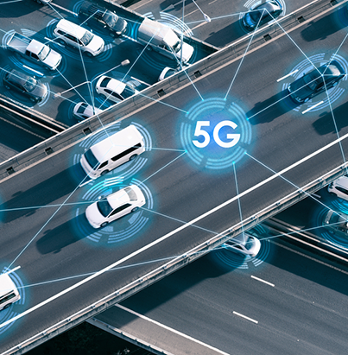
FUTURE SCOPE
Technological Advancements in IoT and AVs
Next-Generation Sensors:
Improved Range and Accuracy.
All-Weather Performance.
Velodyne and Innoviz
Robust Edge Computing:
Tesla’s Full Self-Driving (FSD) - 144 trillion operations/s
Enhanced Communication Systems:
5G and Beyond.
Vehicle Swarming - Coordinated movement of AVs for tasks such as platooning, improving fuel efficiency, and reducing congestion.
AI and Machine Learning Integration:
Nvidia’s Drive AI - unfamiliar environments
Self-Learning Systems.

Slide 22
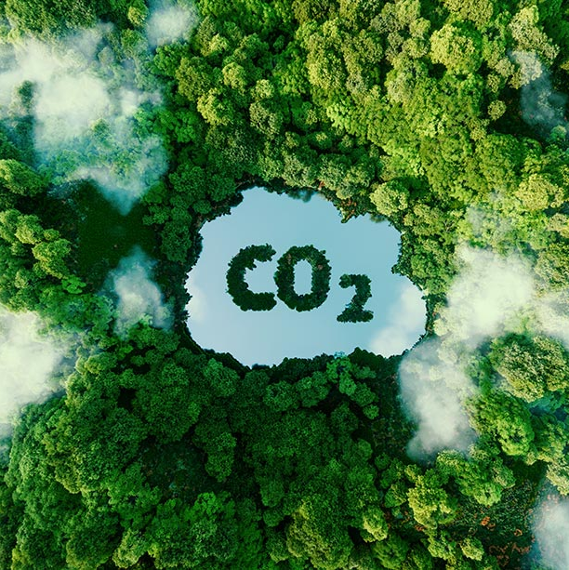
FUTURE SCOPE
Broader Applications and Urban Integration
Smart City Ecosystems:
Singapore - autonomous buses
Public Transport Automation.
Real-Time Urban Planning
Environmental Benefits:
Zero-Emission Zones - london
Advanced Cybersecurity Protocols:
Blockchain Integration - decentralized network
Encryption Upgrades
Global Impact:
Widespread Adoption.
Economic Growth
Japan - tested in remote villages

Slide 23
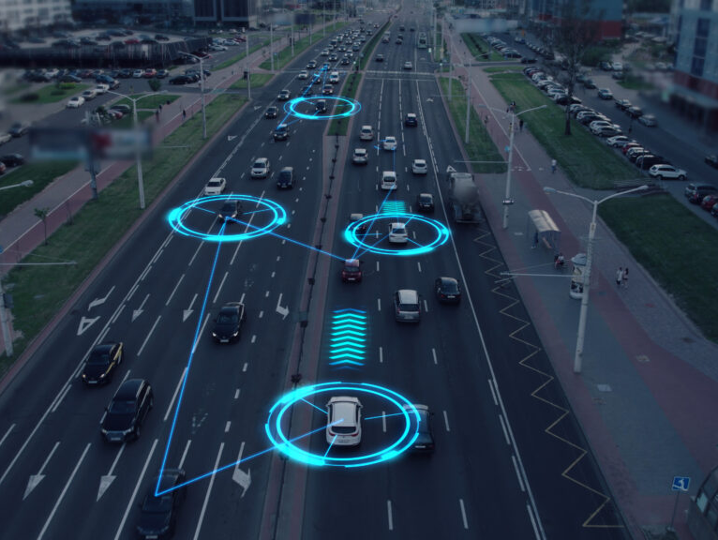
THANK YOU!

